Slide 1
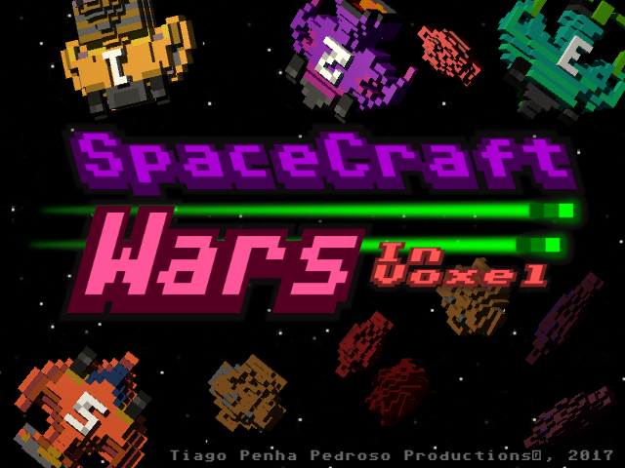
https://creativecommons.org/licenses/by/4.0/

Slide 2




Definitions...
Scoreboard
+
+
+
Space Shooter
Difficult as before
Timer

Slide 3
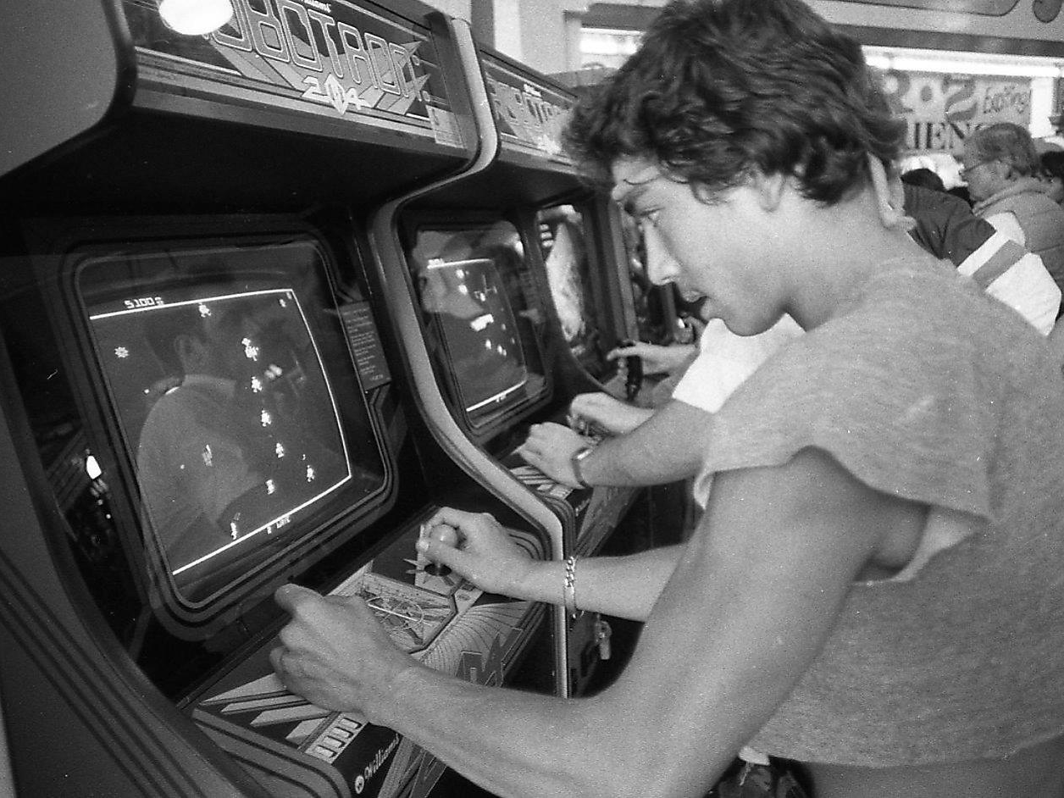
Genre...
http://www.sfgate.com/entertainment/article/Defender-Robotron-creator-still-8355401.php
Phil Lobsinger
Robotron: 2084

Slide 4



Target Audience
They can contain infrequent use of "mild"/cartoon violence and mild language
Violência:
Violência fantasiosa
Sexo e Nudez:
Nudez não erótica.
Drogas:
Consumo moderado

Slide 5

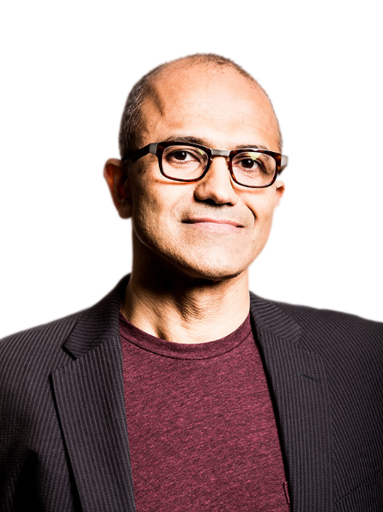
Target Device Analysis
Operating System | 2016 Market Share
Android | 86,2%
IOS | 12,9%
Windows | 0,6%
Blackberry | 0,1%
Others | 0,2%
Total | 100,0%
Anyone want my shares?
Table Source: http://www.gartner.com/newsroom/id/3415117
Nadella News Source: http://www.tudocelular.com/windows/noticias/n76502/ceo-microsoft-vende-mais-de-140-mil-acoes.html; http://finance.yahoo.com/news/microsoft-ceo-satya-nadella-offloads-194607449.html

Slide 6
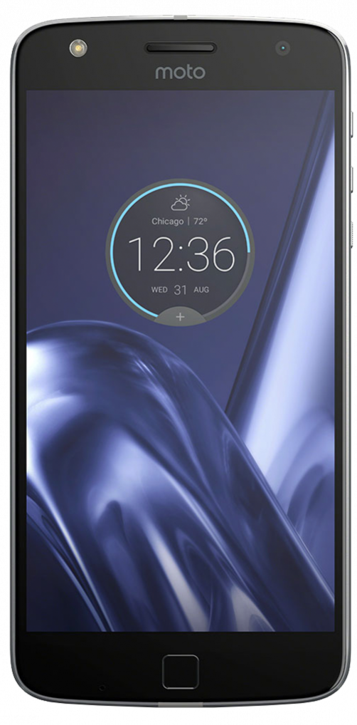
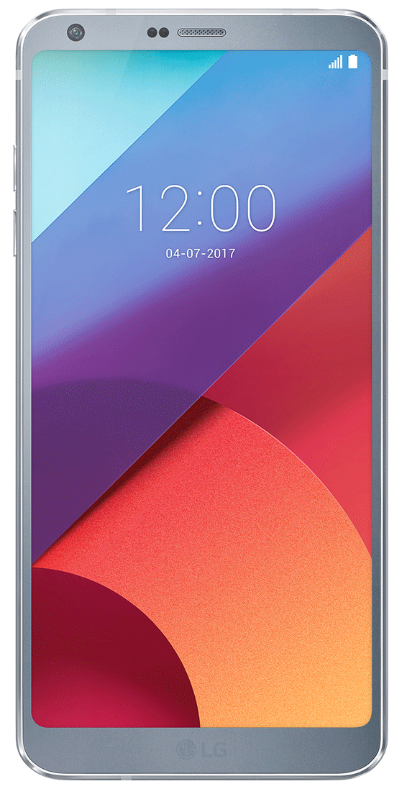
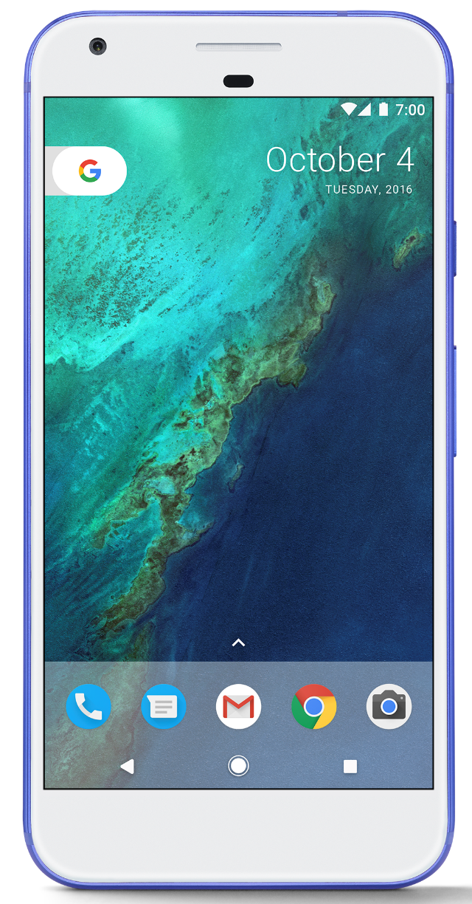
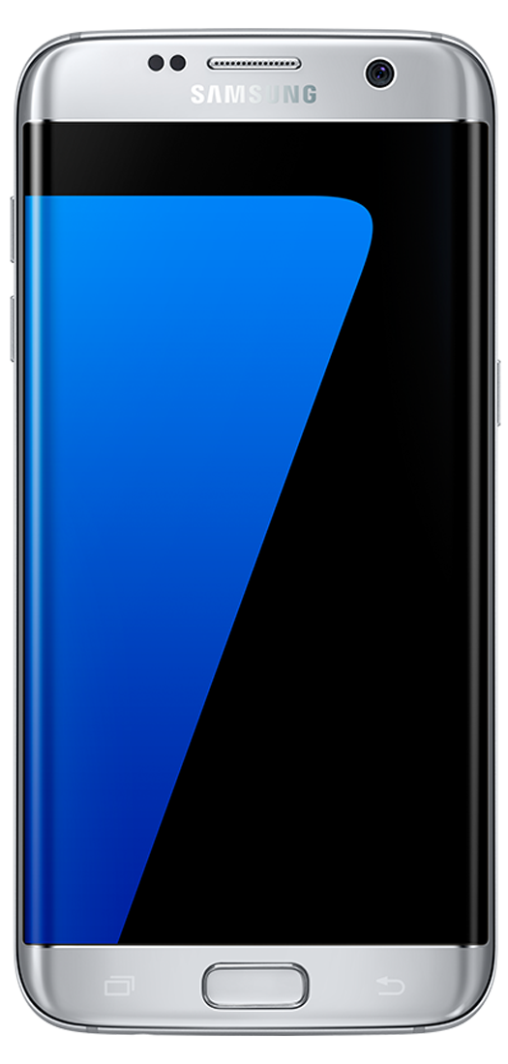

Target Device
Android 6.0

Slide 7

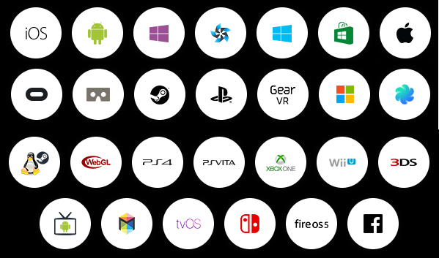
Technology
C#
C#
C#
FREE until $100mil annual
https://unity3d.com/pt/unity/multiplatform
Build Platforms

Slide 8
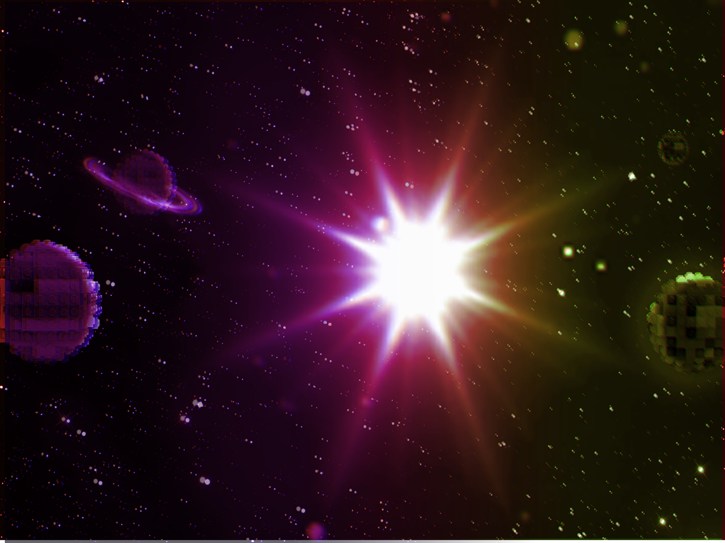
Game Story
[PT-BR]
O Sistema Solar está prestes a ser dizimado porque o Sol explodirá em breve. Porém alguns cientistas descobriram que caso as sete Pedras do Poder fossem reunidas e lançadas no Sol ainda restaria uma chance de reviver a estrela.
A partir de então foi reunida uma tripulação e embarcaram na nave Venture 5 para buscar as Pedras do Poder que estavam espalhadas pelo Sistema Solar. No entanto, as antigas tripulações das outras naves da linha Venture começaram a perseguir o protagonista no intuito de roubar todo do poder das pedras para fugirem em rumo a outra galáxia.
[EN]
The Solar System is about to be wiped out because the sun will explode soon. But some scientists have discovered that if the seven Power Stones were gathered and thrown into the Sun there would still be a chance to revive the star.
From then on a crew was assembled and they embarked in the ship Venture 5 to look for the Stones of the Power that were scattered by the Solar System. Nevertheless, the old crews of the other ships of the Venture line began to persecute the protagonist in order to steal all of the power of the rocks to flee towards another galaxy.

Slide 9
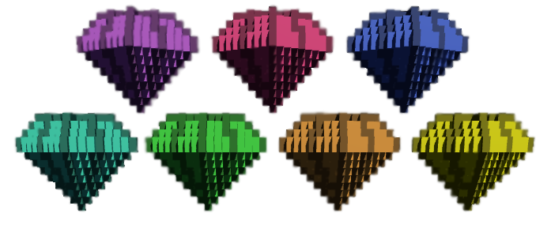
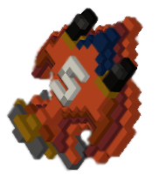
Game Story

Slide 10
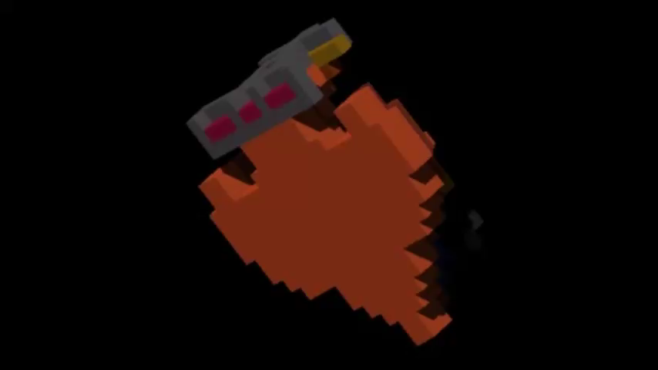
Game Characters
Venture 5
This ship was originally used in manned missions to Neptune.
[player]

Slide 11
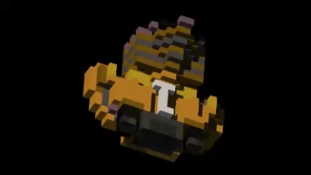
Game Characters
Venture 1 Bee
This ship was originally used in manned missions to Mars.
[enemy]

Slide 12
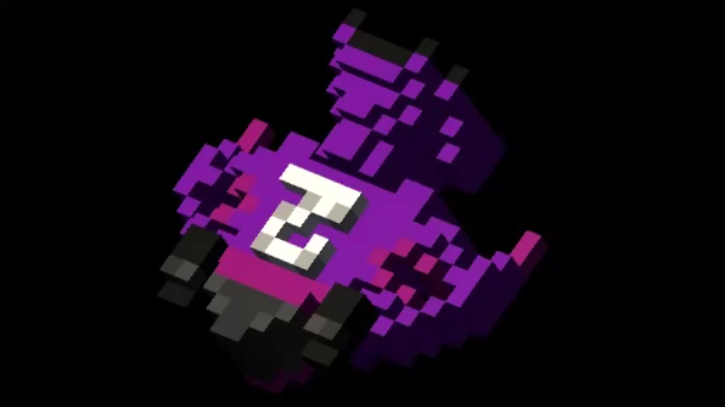
Game Characters
Venture 2 Prize
This ship was originally used in manned missions to create the International Lunar Base.
[enemy]

Slide 13
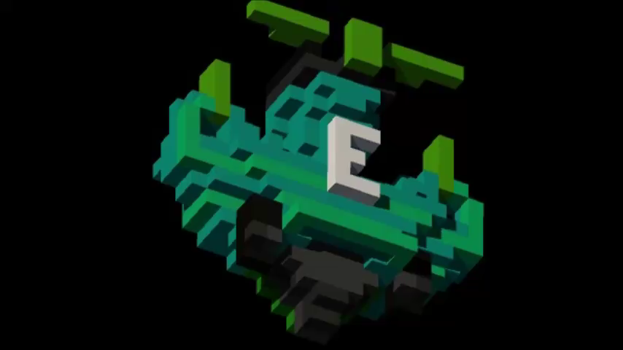
Game Characters
Venture 3 Bug
This ship was originally used in manned missions to Venus.
[enemy]

Slide 14
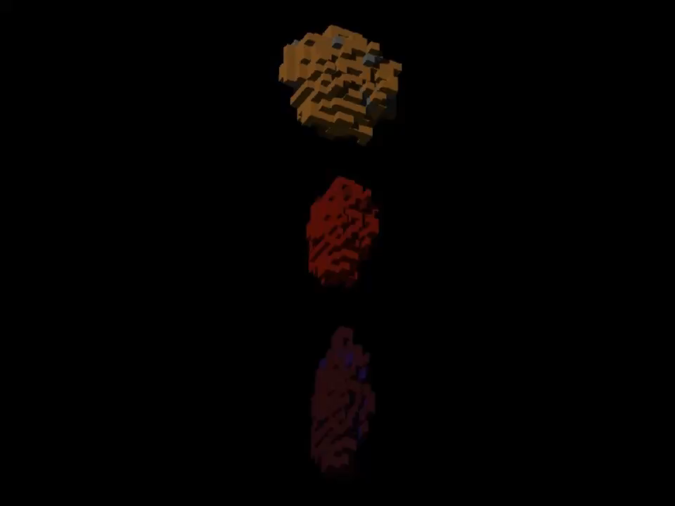
Game Characters
Asteroids
They are lost in space after a mining attempt was made on the Moon in 2025.
[enemy]

Slide 15
Game Screens Chart
Menu
Options
Tutorial
Scoreboard
Credits
Mission
GameLevel
FeedbackMission
GameOver
[01]
[02]
[03]
[04]
[05]
[06]
[07]
[08]
[09]

Slide 16
Game Level Configurations
Fase |  |  | Random Numbers Delimiters
# | Name |  | Number of Enemies (1 Horde) |  | Time (s) between each Horde
 | Inglês | Português | Min. | Max. | Min. | Max.
0 | Trainee | Treineiro | 0 | 2 | 2,9 | 4,5
1 | Easy | Fácil | 1 | 2 | 2,9 | 4,0
2 | Beginner | Iniciante | 1 | 3 | 2,9 | 3,8
3 | Normal | Normal | 1 | 4 | 2,5 | 3,5
4 | Defiant | Desafiador | 2 | 4 | 1,9 | 3,0
5 | Experient | Experiente | 2 | 5 | 1,5 | 2,8
6 | Extremist | Extremista | 3 | 5 | 1,0 | 2,5

Slide 17
Gameplay

Slide 18
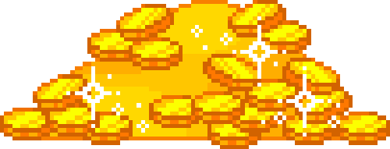
Monetization
16
16
,99
,99
R$
US$

Slide 19
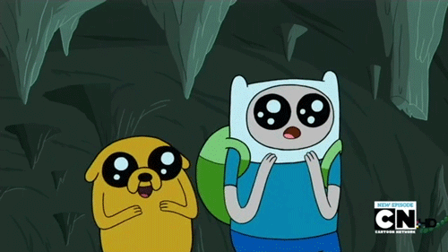
Thanks :)

